Slide 1
A web page for Ordering motor bikes
CAPSTONE PROJECT
Presented By:
SASI.K
B TECH-INFORMATION TECHNOLOGY(III-YEAR)
NEHRU INSTITUTE OF TECHNOLOGY

Slide 2
OUTLINE
Problem Statement
Proposed System/Solution
System Development Approach
Algorithm & Deployment
Result
Conclusion
Future Scope
References

Slide 3
Problem Statement
Create a web page that enables customers to browse, customize, and order bikes online. The page should offer an easy-to-use interface for selecting and purchasing bikes, ensuring a smooth shopping experience.
Key Features:
Bike Selection:
Display a list of available bikes with images, descriptions, and key details (e.g., type, size, price).
Provide filters to sort bikes by type (e.g., mountain, road, hybrid) and size.
Customization:
Allow customers to select bike colors, accessories (e.g., helmets, racks), and upgrades (e.g., premium tires).
Update total price dynamically based on customizations.
Shopping Cart:
Enable users to add bikes and accessories to the cart.
Show an itemized summary with prices and quantities.
Allow customers to update or remove items from the cart.
Checkout Process:
Collect shipping information and calculate shipping costs based on location.
Provide multiple payment options (e.g., credit card, PayPal).
Display a final order summary for review before completing the purchase.
Order Confirmation:
Send an order confirmation email with order details and tracking information.
..
.
…..

Slide 4
Proposed Solution
To address the problem of creating a web page for ordering bikes, the solution involves designing an intuitive and responsive interface that allows users to easily browse, customize, and purchase bikes. The page will display a comprehensive catalog of available bikes with detailed descriptions, images, and key information such as type, size, and price. Users can filter and sort bikes based on criteria like type (e.g., mountain, road, hybrid) and size, helping them quickly find what they’re looking for.
To enhance the user experience, the system will offer customization options, allowing customers to select bike colors, accessories (such as helmets, locks, and racks), and upgrades (e.g., premium tires or seats). The total price will automatically update as users make their selections, ensuring transparency throughout the process. Once customers have selected their bikes and accessories, they can add them to the shopping cart, where they can view a detailed summary of the items, adjust quantities, or remove products.

Slide 5
System Approach
Software : The project utilized the free version of Figma, an online collaborative interface design tool, to develop the responsive landing page. Figma was chosen for its user-friendly interface, robust prototyping features, and ability to create responsive designs seamlessly. It allowed the design process to include features such as interactive elements, smooth transitions, and device-specific layouts (desktop, tablet, and mobile views) without requiring extensive coding knowledge. The tool’s cloud-based environment enabled efficient file management and easy iteration on designs.
Hardware:The project was developed using a Acer Aspire 3, equipped with the following configurations:Processor: AMD Ryzen 7 7840HSRAM: 16GB DDR5, enabling smooth multitasking and handling of resource-intensive tasks like Figma.Graphics Card: NVIDIA GeForce RTX 4060, ensuring high performance for rendering designs and prototypes.Storage: 1TB SSD, providing ample space for storing project files and design resources.Display: 15.6-inch FHD screen with a 144Hz refresh rate, ensuring accurate and vibrant visual representation during the design process.

Slide 6
TECHNIQUES & Deployment
To develop and deploy the bike ordering web page, modern web development techniques and deployment strategies will be employed to ensure a scalable, secure, and user-friendly system. On the front-end, frameworks like React or Vue.js will be used to build a dynamic, single-page application (SPA) that provides real-time updates and an intuitive, mobile-friendly experience. HTML5, CSS3, and responsive design principles will ensure the page adapts seamlessly across devices. The back-end will be powered by Node.js with the Express framework or Django, which are well-suited for handling real-time requests like filtering the bike catalog, processing orders, and integrating with payment gateways. RESTful APIs will facilitate smooth communication between the front-end and back-end systems.
For data management, a relational database such as MySQL or PostgreSQL will store bike catalog information, user profiles, orders, and transaction details, while NoSQL databases like MongoDB can be used for unstructured data storage. Secure user authentication will be handled using JWT (JSON Web Tokens) or OAuth for third-party logins, and SSL/TLS encryption will protect data during transmission. For payment processing, third-party services like Stripe or PayPal will be integrated to securely manage transactions and protect sensitive information.
When it comes to deployment, the web application will be hosted on cloud platforms like AWS or Heroku, offering scalable and reliable environments. AWS EC2 and RDS can handle the server and database needs, while Heroku provides a more simplified deployment process. A Continuous Integration/Continuous Deployment (CI/CD) pipeline will be set up using Jenkins or GitHub Actions to automate testing, building, and deploying the application. Additionally, a Content Delivery Network (CDN) like Cloudflare will be used to improve site performance by caching static resources, thus speeding up loading times for global users.

Slide 7
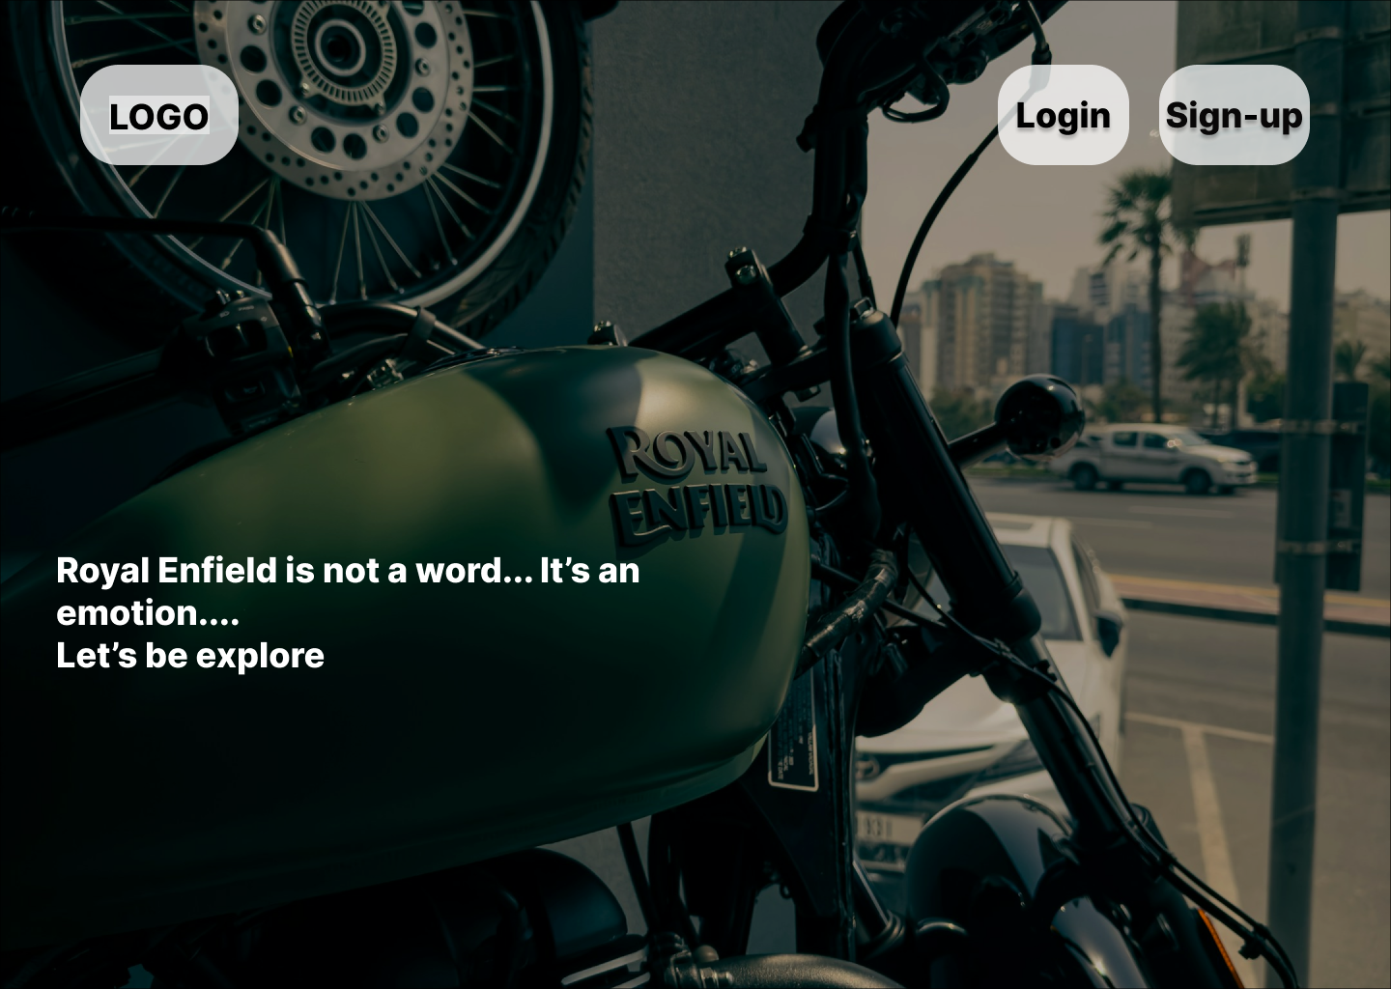
Result

Slide 8
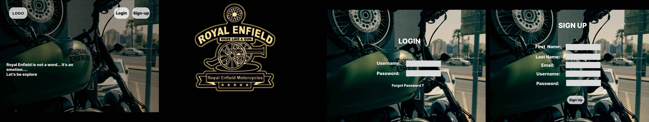
Result

Slide 9
Conclusion
In conclusion, the proposed solution for the bike ordering web page utilizes modern web development techniques and best practices to create a seamless, secure, and scalable online shopping experience. By combining dynamic front-end frameworks like React or Vue.js with robust back-end technologies such as Node.js or Django, the system ensures efficient handling of user interactions, real-time updates, and secure transactions. The integration of payment gateways like Stripe or PayPal further guarantees safe processing of customer payments.
Overall, this approach ensures that the bike ordering web page will meet the needs of customers, deliver a secure and efficient user experience, and remain flexible and scalable as the business expands.

Slide 10
Future scope
The future scope of the bike ordering web page offers numerous opportunities for growth, innovation, and customer engagement. One key area for expansion is personalization, where machine learning algorithms could be used to provide tailored bike recommendations based on user preferences, browsing history, or past purchases, enhancing the shopping experience and boosting conversion rates. Additionally, the platform could introduce more advanced customization features, such as interactive 3D bike builders or virtual fitting rooms, allowing users to visualize and customize bikes in real-time. Another potential development is the addition of subscription services, such as bike maintenance or accessory packages, which would provide customers with regular, automated updates and enhance brand loyalty.
Finally, forming collaborations with bike manufacturers, sports brands, or local bike shops would expand product offerings, while strategic partnerships with delivery services could improve logistics and shipping efficiency. By embracing these innovations and responding to market trends, the bike ordering platform can remain competitive, adaptable, and continue to provide exceptional value to its customers.

Slide 11
References
https://www.figma.com/design/T5SOb9ZuxGgz1HrNYHkplT/SASI-NAAN?node-id=0-1&node-type=canvas&t=idGEEkjnctWs7FiC-0

Slide 12
THANK YOU

